Slide 1
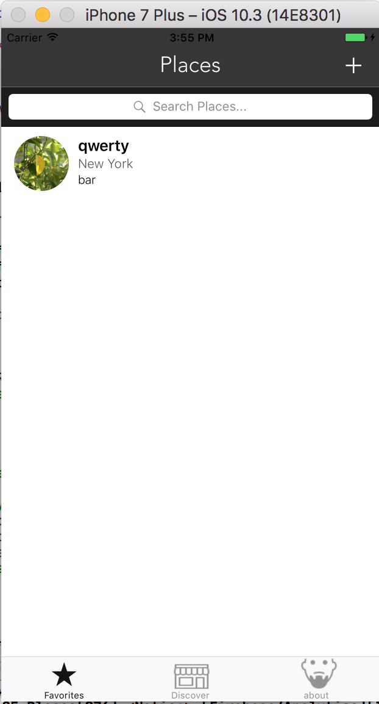
Places

Slide 2
Places
Finding the place for visit

Slide 3
Places
Finding the place to visit
Simple to use

Slide 4
Places
Finding the place for visit
Simple to use
Remember the place where you have been

Slide 5
Places
Finding the place for visit
Simple to use
Remember the place where you have been
Rating the places

Slide 6
Places
Finding the place for visit
Simple to use
Remember the place where you have been
Rating the places
Support ukrainian developer

Slide 7
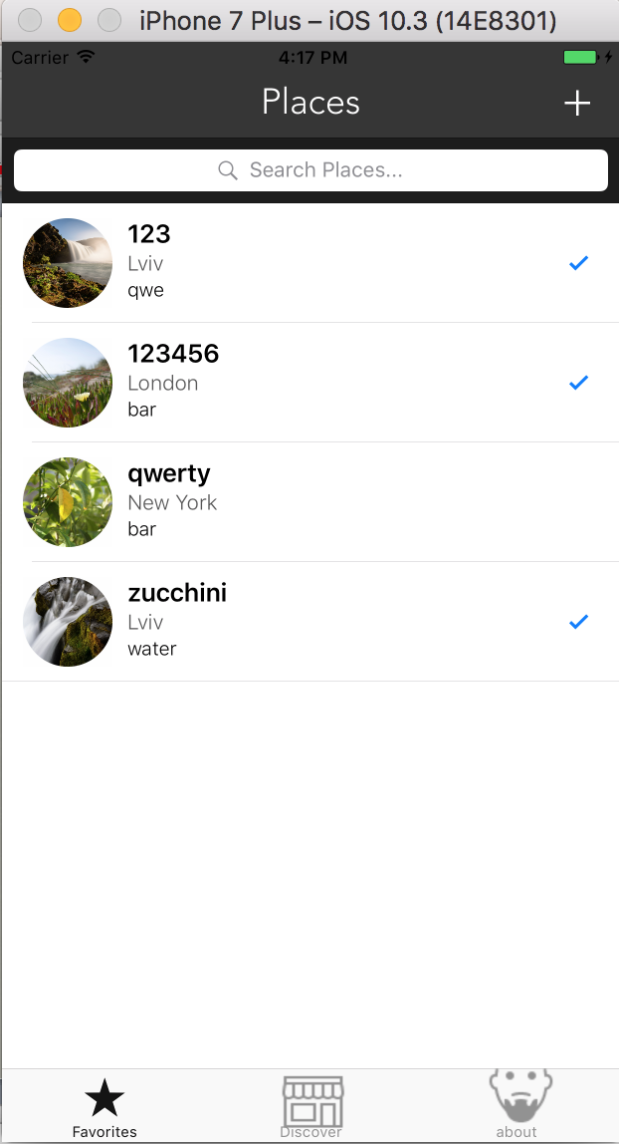
What we can do in this app?
Add your own place

Slide 8
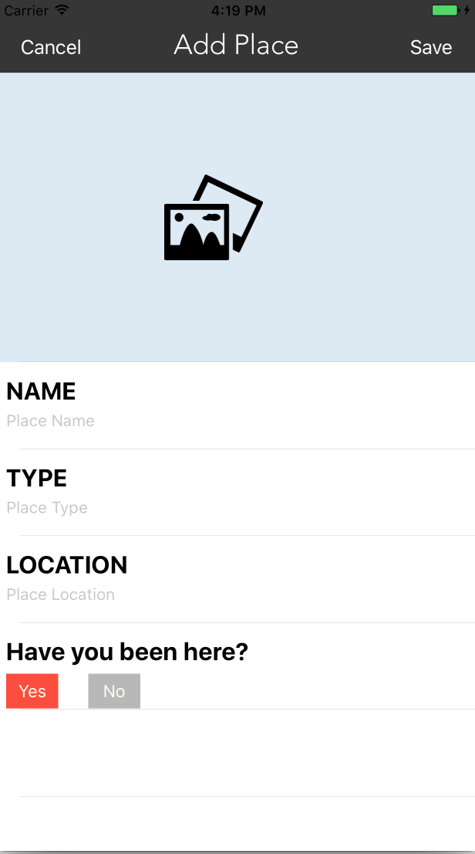
What we can do in this app?
Add your own place

Slide 9
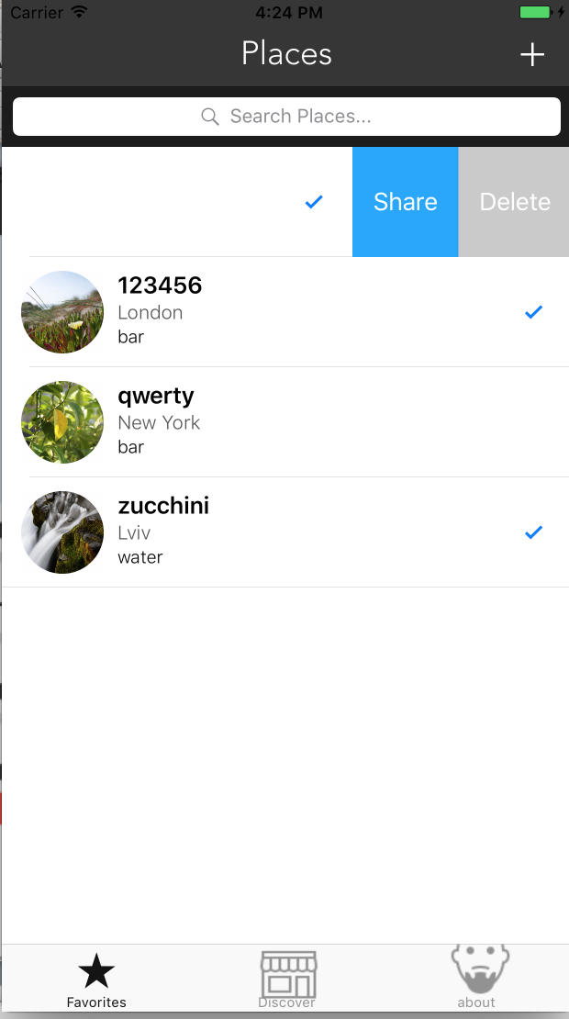
What we can do in this app?
Add your own place
Swipe to share or delete place

Slide 10
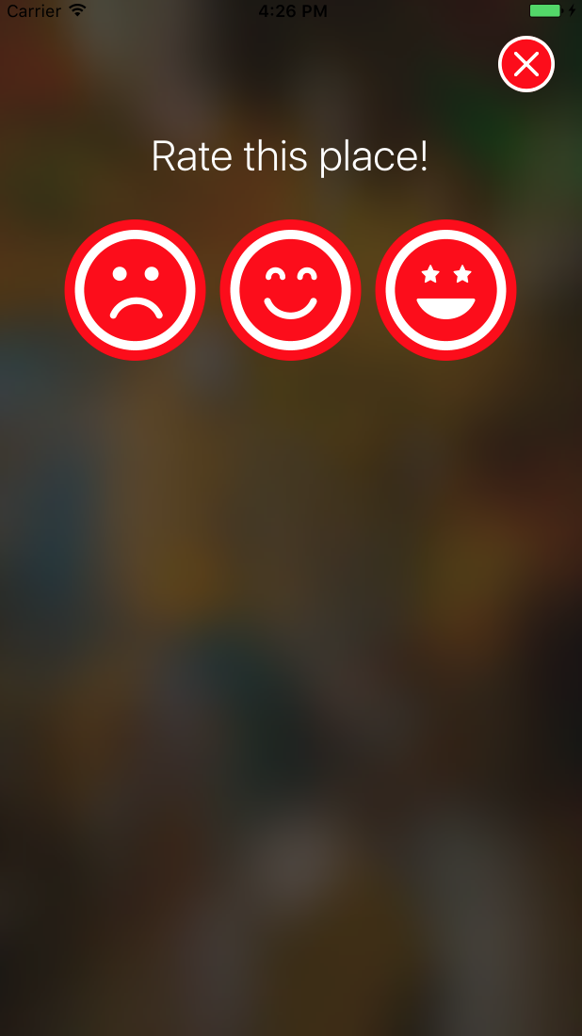
What we can do in this app?
Add your own place
Swipe to share or delete place
Rate this place

Slide 11
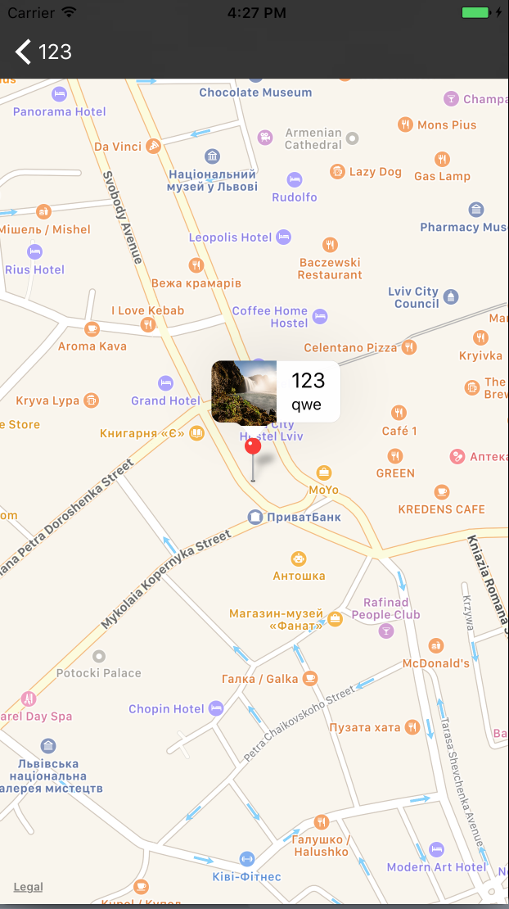
What we can do in this app?
Add your own place
Swipe to share or delete place
Rate this place
You can see the location of this place

Slide 12
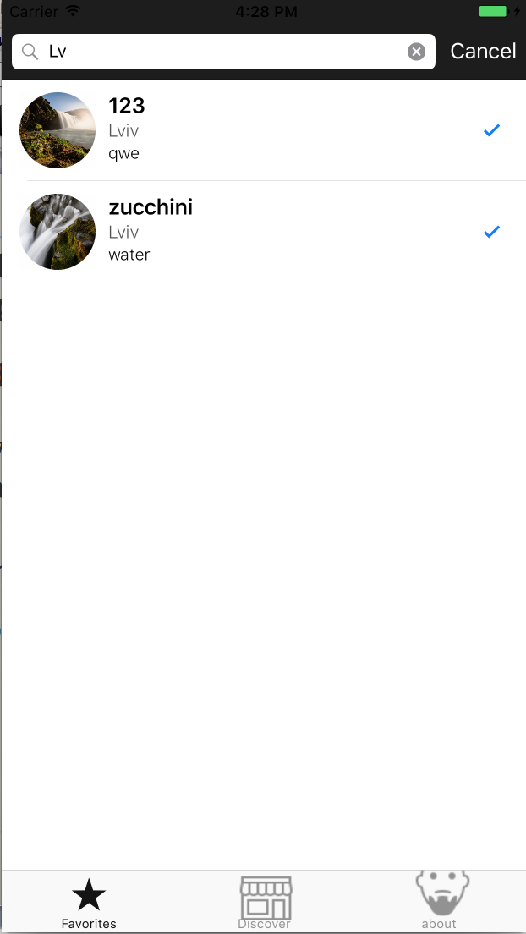
What we can do in this app?
Add your own place
Swipe to share or delete place
Rate this place
You can see the location of this place
You can search the places

Slide 13
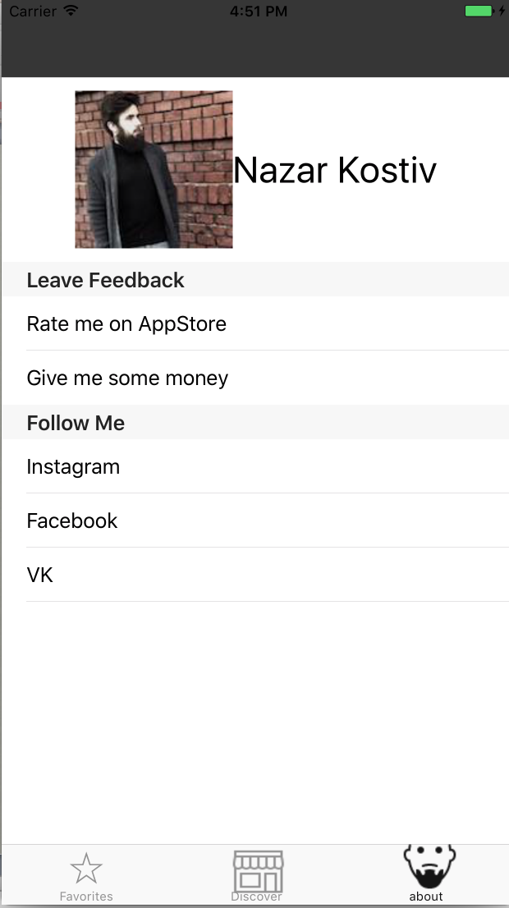
If you like my app,you can :

Slide 14
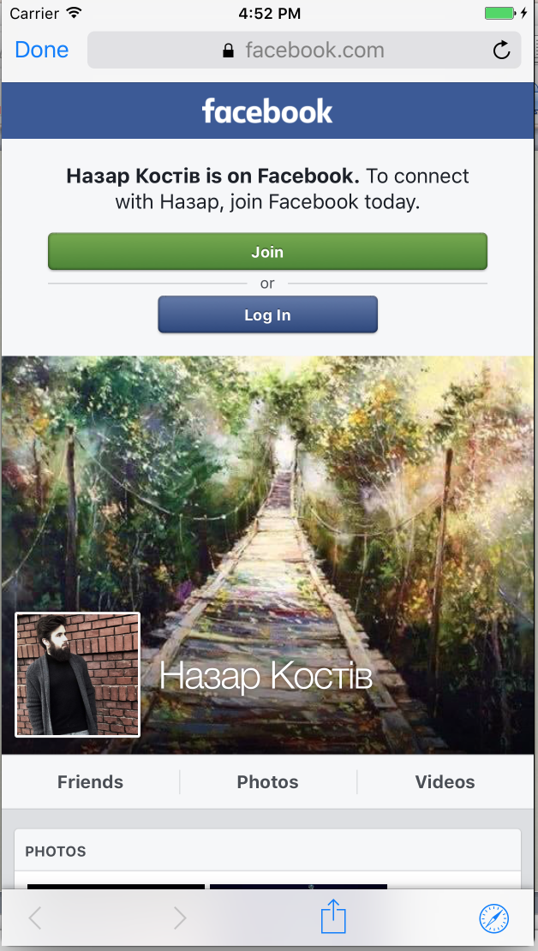
If you like my app,you can :
Follow and like my insta,fb,vk

Slide 15
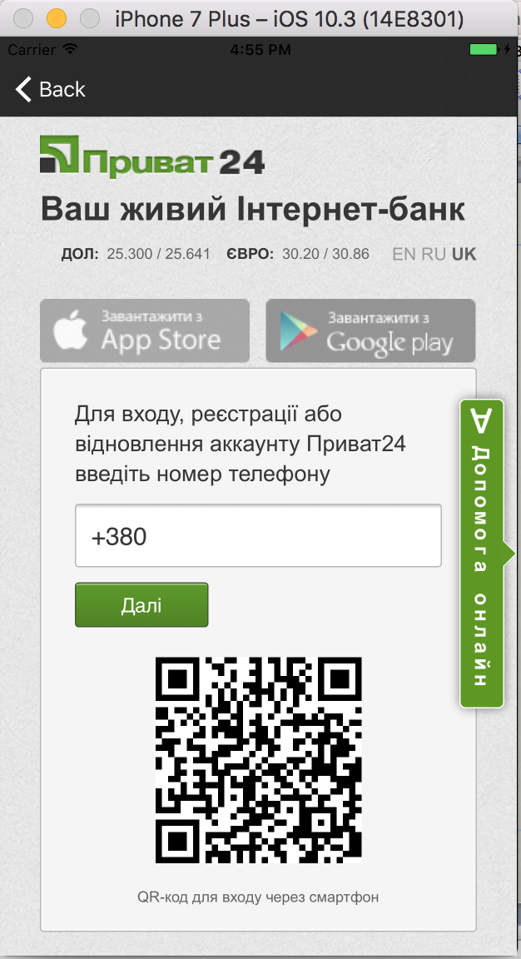
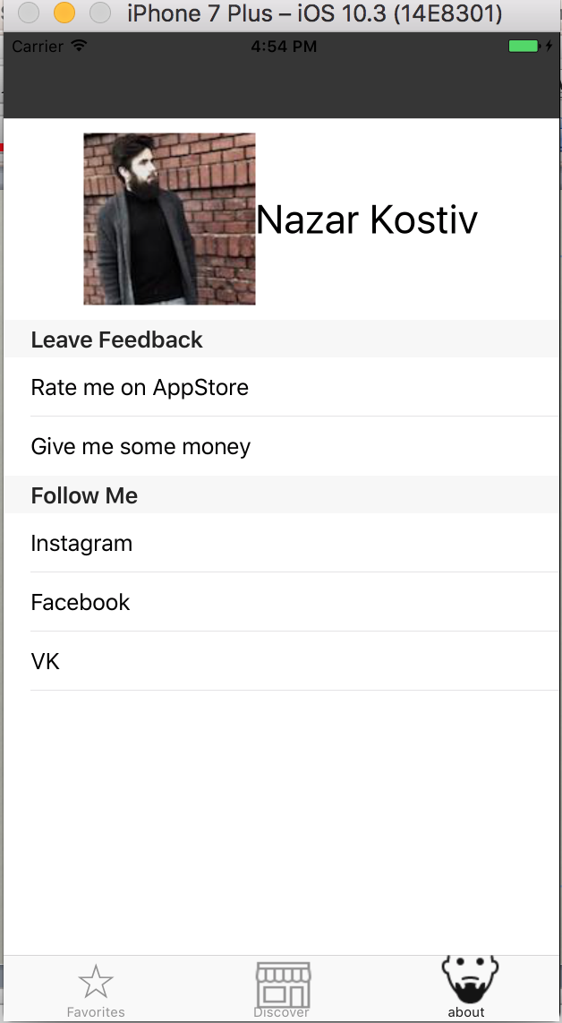
If you like my app,you can :
Follow and like my insta,fb,vk
Rate me on app store
Give me some money

Slide 16
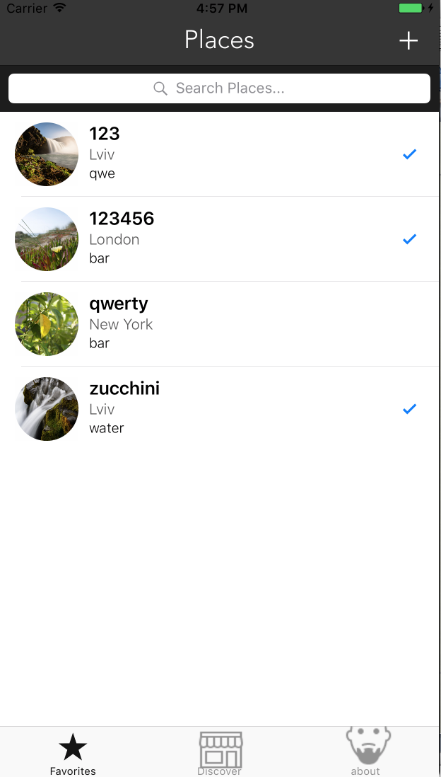
Improving

Slide 17
Improving
Fix rate view

Slide 18
Improving
Fix rate view
Add firebase

Slide 19
Improving
Fix rate view
Add firebase
Localized

Slide 20
Improving
Fix rate view
Add firebase
Localized
Phone number

Slide 21
Conclusion
We Have multi functional app

Slide 22
Conclusion
We Have multi functional app
We have a great design

Slide 23
Conclusion
We Have multi functional app
We have a great design
Very simple in use

Slide 24
Conclusion
We Have multi functional app
We have a great design
Very simple in use
So in my opinion this app has a place to live in app store, or I hope so = )

Slide 25
Thanks you For your attention

